Slide 1
Chapter 2: System Models

Slide 2
Intro
An architectural model of DS defines the ways in which the components of the systems interact with each other and the way in which they are mapped on to an underlying network of computers e.g. client-server & peer process model, mobile agents in terms of client server model etc.
Fundamental models help to reveal key problems for the designers of DS. Purpose is to specify the design issues, difficulties and threats that must be resolved in order to develop systems that fulfill their tasks correctly.

Slide 3
2.2-Architectural Models
The architecture of a sys is its structure in terms of separately specified components
Major concerns are to make the sys reliable, manageable, adaptable & cost-effective
An architectural model of a DS first simplifies & abstract the functions of the individual components of a DS & then it considers
  The placement of the components across a n/w of computers – seeking to define useful patterns for the distribution of data & workload
  The interrelationship b/w the components – that is, their functional roles & the patterns of communications b/w them
First we classify the processes. Classifying processes (Server, client & peer processes) help us to assess their workload & determine the impact of failures in each of them.
Some more dynamic systems can be built as variations on the client-server model

Slide 4
2.2.1-Software Layers
The term software architecture referred originally to the structuring of software as layers or modules in a computer and recently in terms of services offered and requested b/w processes located on the same or diff computers.
A Server is a process that accepts requests from other processes
A dist service can be provided by one or more server processes interacting with each other and with other client processes in order to maintain the consistent system wide view of the service resources. E.g. search engine.

Slide 5
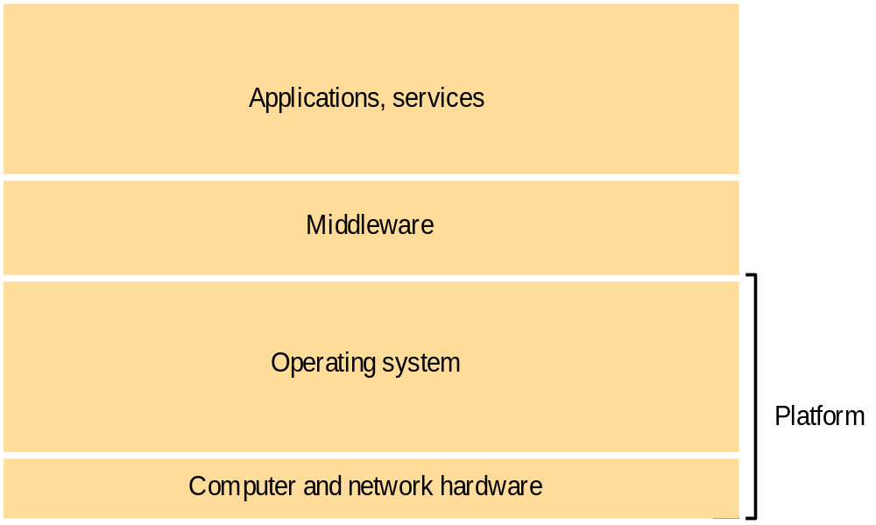
Software and hardware service layers in DS
Domain-specific services that uses the M/W
M/W is represented by processes or objects in a set of computers that interact with each other to implement communication & resource sharing support for dist app
Mask heterogeneity & to provide a convenient prog. Model to app. programmers
Sun RPC, OMG’s CORBA, java RMI, Microsoft DCOM
Intel x86/windows
Sun Sparc/SunOS
Intel x86/Solaris
PowerPC/MacOS Intel x86/Linux

Slide 6
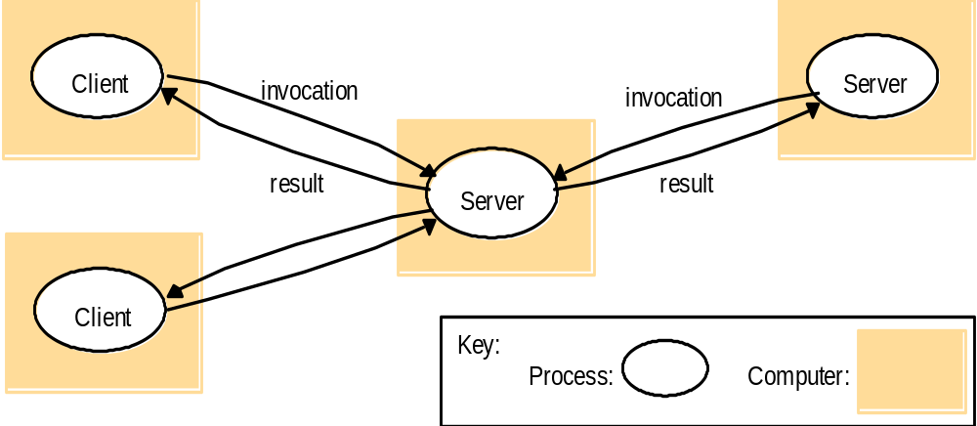
Clients Server
Historically the most important & remains most widely employed model
Servers may in tern be clients of other servers
  A web server is often a client of local file server in which the web pages are stored
  Search engines – result summaries made by the programs.
    Search engine is both a server and a client
request
reply

Slide 7
Peer to Peer
All processes involved in a task play similar roles. No distinction between client and server. We define the resources which we want to share and such things are being shared.
Figure 2.3 indicates that applications are composed of large number of peer processes running on the separate computers. Large number of data objects are shared. E.g. Limewire, Napster etc

Slide 8
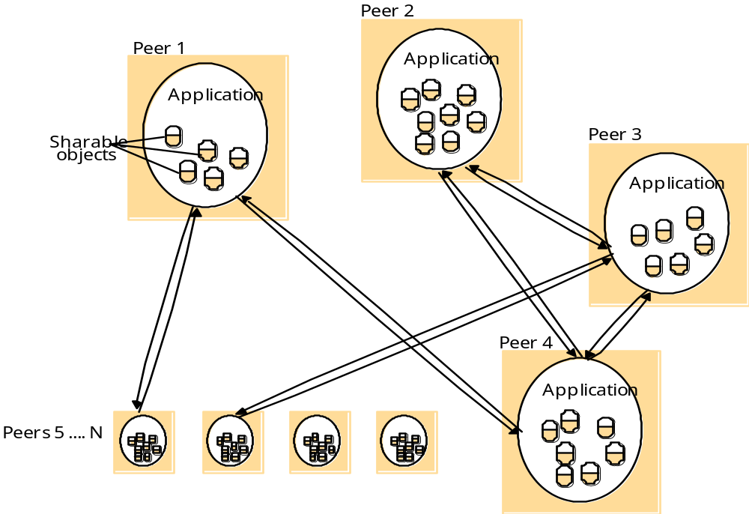
Peer to Peer (cotnd.)
A distributed application based on peer processes

Slide 9
2.2.3-Variations on the Client-server Model
Several variations on the client-server model can be derived from the consideration of the following factors.
  Use of multiple servers and caches to enhance the performance
  The use of mobile code & mobile agents
  User’s need for low-cost computers with limited hardware resources that are simple to manage

Slide 10
A service provided by multiple servers
Services may be implemented as several server processes in separate host computers interacting with each other to provide the service to the clients.
The servers may partition the set of objects on which the service is based & distribute them b/w themselves or they may maintain replicated copies of them on several hosts.
  The web provides a common example of portioned data in which each servers manages its own resources. Replication is used to increase performance & availability & to improve fault tolerance.

Slide 11
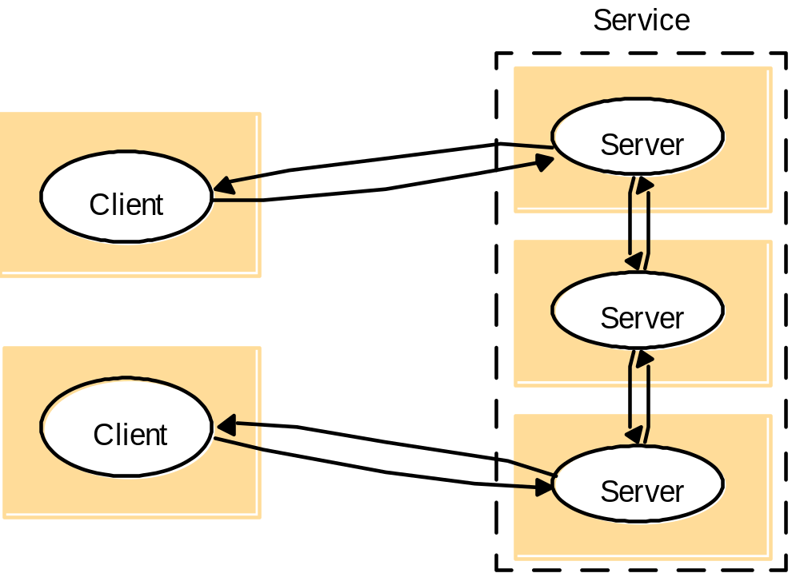
A service provided by multiple servers (contd.)

Slide 12
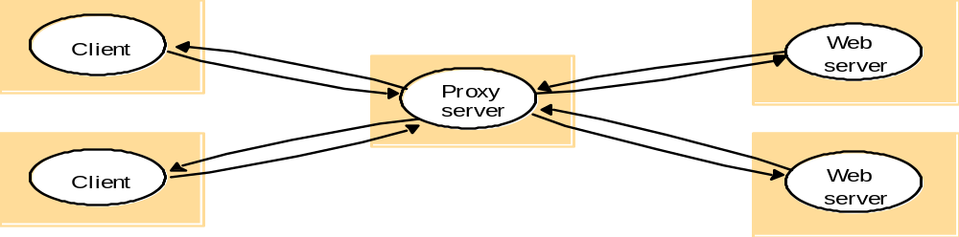
Web proxy server
A cache is a store of recently used data objects that is closer than the objects themselves
Caches may be collected by each client or at a proxy servers that can be shared by many clients
Web browsers maintain a cache of recently visited web pages & other web resources in the client’s local file system
Web proxy servers provide a shared cache of web resources for the client machines at a site or across several sites
The purpose of proxy servers is to increase availability & performance of the service by reducing the load on WAN & web servers.

Slide 13
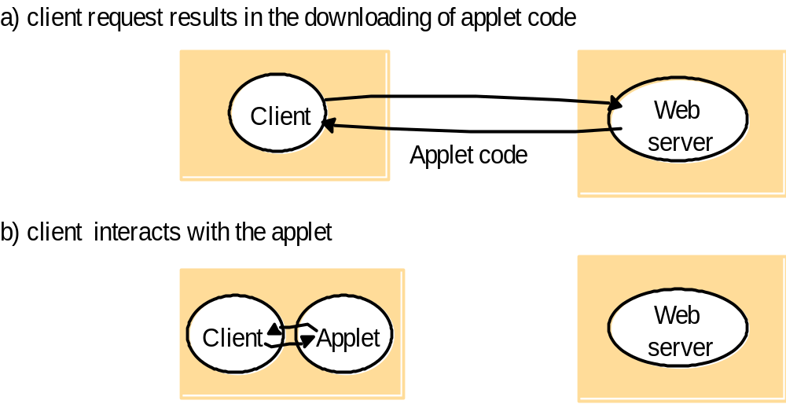
Web applets (mobile code)
The advantage of downloaded code locally is the good interactive response
Mobile code is a potential security threat to the local resources in the destination computer

Slide 14
Push Model
Accessing services means running code that can invoke their operations. Some services are likely to be so standardized that we can access them with an existing well-known app –the web is the most common example.
Some web sites use functionality not found in standard browsers & require downloading of additional code.
Consider an app that requires that user should be kept up to date with changes as they occur at an information source in the server.
The solution is to use additional s/w that operates in a manner often referred to as push model-one in which server instead of the client initiates interactions.

Slide 15
Mobile Agents
Mobile Agents
A mobile agent is a running prog (including both code & data) that travels from one computer to another in a network carrying out a task on someone’s behalf. Possible uses like
  Install & maintain software on computers within an organization
  Compare the prices of products from a number of vendors by visiting sites
  Use of idle computers in order to carry out intensive computations
Mobile agents like mobile code are potential security threat to the resources in visiting computers.

Slide 16
Thin clients and compute server
This architecture has the same low management & h/w cost as the network computer scheme
Instead of downloading the code of applications into the user’s computer, it runs them on a compute server
The compute server must be fast machine
Main drawback is in highly interactive graphical activities such as CAD & image processing
Compute server
Network computer or PC
Thin
network
Application
Client
Process

Slide 17
Design requirements for Distributed Architecture
Performance issues
  Responsiveness (sys must be composed of fewer layers for higher response)
  Throughput (processing speed, data transfer rate)
  Balancing computational loads (more than one servers to provide one service)
Quality of service
  Main non-functional properties of sys that effect the quality of service experienced by clients & users are reliability, security, performance, adaptability & resource availability
Dependability issues
  Fault tolerance (Redundancy, replicas)
  Security

Slide 18
Fundamental Models
A system model has 3 questions.
  What are the main entities in a system?
  How do they interact?
  What are the characteristics that affect their individual & collective behavior?
The purpose of the model is
  To make explicit all the relevant assumptions about the systems we are modeling.
  To make generalizations concerning what is possible or impossible, given those assumptions.
The aspects of DS that we cover in fundamental models are about
  Interaction
  Failure
  Security

Slide 19
Interaction Model
DS are composed of many processes, interacting in complex ways
The behavior of DS composed processes can be defined by a distributed algorithm – a def of steps to be taken by each of the processes of which the sys is composed, including the transmission of messages between them
Significant factors affecting interacting processes in a DS
  Communication performance is often a limiting characteristic
  It is impossible to maintain a single global notion of time
Notes:
DS are composed of many processes, interacting in complex ways
Multiple server processes may cooperate with one another to provide a service
Domain Name service: partition & replicate its data at servers throughout the internet
A set of peer processes may cooperate with one another to achieve a common goal
A voice conferencing sys that distributes streams of audio data in a similar manner

Slide 20
Cont
Performance of communication channels
  Performance characteristics relating to latency, bandwidth & jitter
Computer clocks and timing events (clock drift rate)
Two variants of the interaction model Synchronous DS (possible to use timeouts)
    The time to execute each step of a process has a known lower & upper bounds
    Each transmitted message is received within a known bounded time
    Each process has a local clock whose drift from real time has a known bound
  Asynchronous DS (internet)
    Variable process execution speed
    Arbitrary message transmission delays
    Arbitrary clock drift rates
  Actual DS are very often asynchronous

Slide 21
Failure Models
Failures of processes & communication channels
Omission failures (process or communication channel fails to perform actions)
    Process omission failure
      Chief omission failure of a process is to crash
      Crash detection can rely on the use of timeouts
      In an asynchronous sys a timeout can indicate only that a process is not responding
      Fail-stop behavior can be produced in a synchronous sys using timeouts detection
    Communication omission failure
      Dropping messages
  Arbitrary failures (the worst possible failure semantics)
  Timing failures (applicable in synchronous DS, multimedia computers)

Slide 22
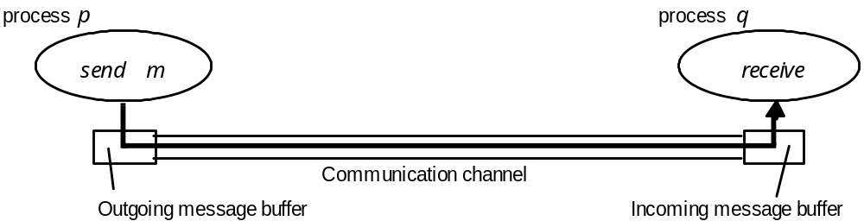
Omission Failures (Processes and channels)
Dropping messages: lack of buffer space at receiver or intervening gateway, or by a n/w transmission error
Send-omission failure: loss of msg b/w the sending process & outgoing msg buffer
Receive-omission failure: loss of msg b/w the incoming msg buffer & the receiving process
Provided by the OS

Slide 23
Omission and arbitrary failures
Class of failure
Affects
Description
Fail-stop
Process
Process halts and remains halted. Other processes
detect this state.
Crash
Process
Process halts and remains halted. Other processes may
not be able to detect this state.
Omission
Channel
A message inserted in an outgoing message buffer never
arrives at the other end’s incoming message buffer.
Send-omission
Process
A process completes a
send,
but the message is not put
in its outgoing message buffer.
Receive-omission
Process
A message is put in a process’s incoming message
buffer, but that process does not receive it.
Arbitrary
Process or
Process/channel exhibits arbitrary behaviour: it may
(Byzantine)
channel
send/transmit arbitrary messages at arbitrary times,
commit omissions; a process may stop or take an
incorrect step.

Slide 24
Security Model
The security of DS can be achieved by securing the processes & the channels used for their interactions and by protecting the encapsulated objects against unauthorized access
Protecting objects
A model for analysis of security threats (Following Topics)
  The enemy
    Threats to processes
      Servers
      Clients
    Threats to communication channels
    Defeating security threats
      Cryptography & shared secrets
      Authentication
      Secure Channels
    Other possible threats
      Denial of service (network bandwidth, server processing capacity)
Access rights
Object
invocation
Client
result
Server
Principal (user)
Network
Principal (server)

Slide 25
The enemy
Copy of
m
The enemy
m’
Process
p
m
Process
q
Communication channel
Secure channels
Principal
A
Principal
Process
p
Secure channel
Process
q

